Slide 1

RIPHAH INTERNATIONAL UNIVERSITY SCHOOL OF COMPUTING AND INNOVATION (RSCI)
SEMESTER PROJECT – OBJECT ORIENTED PROGRAMMING

Slide 2
About StUDENT
NAME : ABDULLAH TAUFIQ
SAP I’D : 29191
SUBJECT : OBJECT ORIENTED PROGRAMMING
TEACHER : SIR HAROON

Slide 3
PROJECT - TITLE
PHARMACY MANAGEMENT SYSTEM

Slide 4
Functionalities
This project provide us different useful functionality such as :
To place order
To search specific Record
To display all Record
To update data
To delete specific and and full data
In This Project I also add External Sound

Slide 5
Tools and programming language
In this Project I will use only 1 programing Language that is C++ and I use Dev compiler

Slide 6
Concepts Of OOPS
I create this program by using these concepts of oop :
Incapsulation
Multiple Inheritance
Interphase

Slide 7
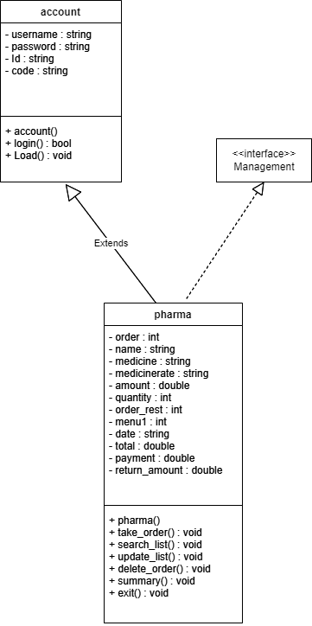
Class diagram

Slide 8
Conclusion
This Project helps me a lot to build my concepts and also helps me to learn some new Ideas and concepts.

